Slide 1

GOAC Analytic Solutions
Brett Vogelsang
Computer Science Student
Lenoir-Rhyne University

Slide 2
NOTICE ON PLAGARISM – KEEP THIS SLIDE
THIS IS A VERY IMPORTANT PROJECT FOR YOUR MAJOR
IT DEMONSTRATES THAT YOU CAN BUILD DATABASES, LOAD DATA, AND BUILD A FRONT END DASHBOARD SOULTION
IT ALSO DEMONSTRATES YOUR ABILITY TO EXTEND WHAT WE COVER IN THE CLASSROOM TO A PRACTICAL PROJECT THAT YOU ARE LIKELY TO GET IN YOUR JOBS
FINALLY, IT DEMONSTRATES YOUR ABILITY TO LEARN NEW TECHNOLOGIES ON YOUR OWN WITH ONLY MANAGEMENT DIRECTIONS.
IT IS AN INDIVIDUAL PROJECT
IF YOU SUBMIT ANYONE ELSES SLIDES, IMAGES, CODE, DATABASE, OR PARTS OF THIS FOR ANY REASON, YOU WILL FAIL THIS COURSE. DO NOT SHARE ANY CODE, EVEN FOR ILLUSTRATION PURPOSES, OR HELPING ANOTHER STUDENT.
THE PERSON SHARING HER/HER CODE WILL ALSO FAIL THIS COURSE.

Slide 3
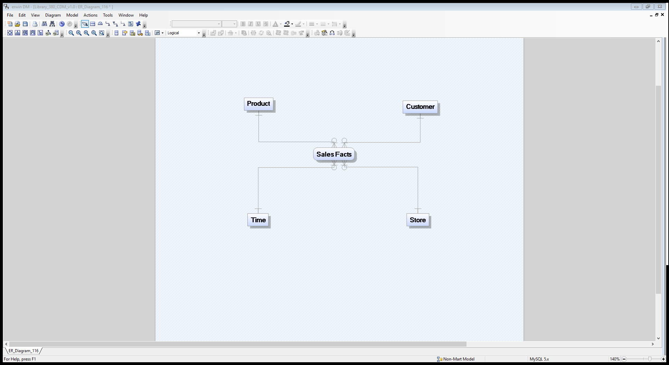
The Database - CDM

Slide 4
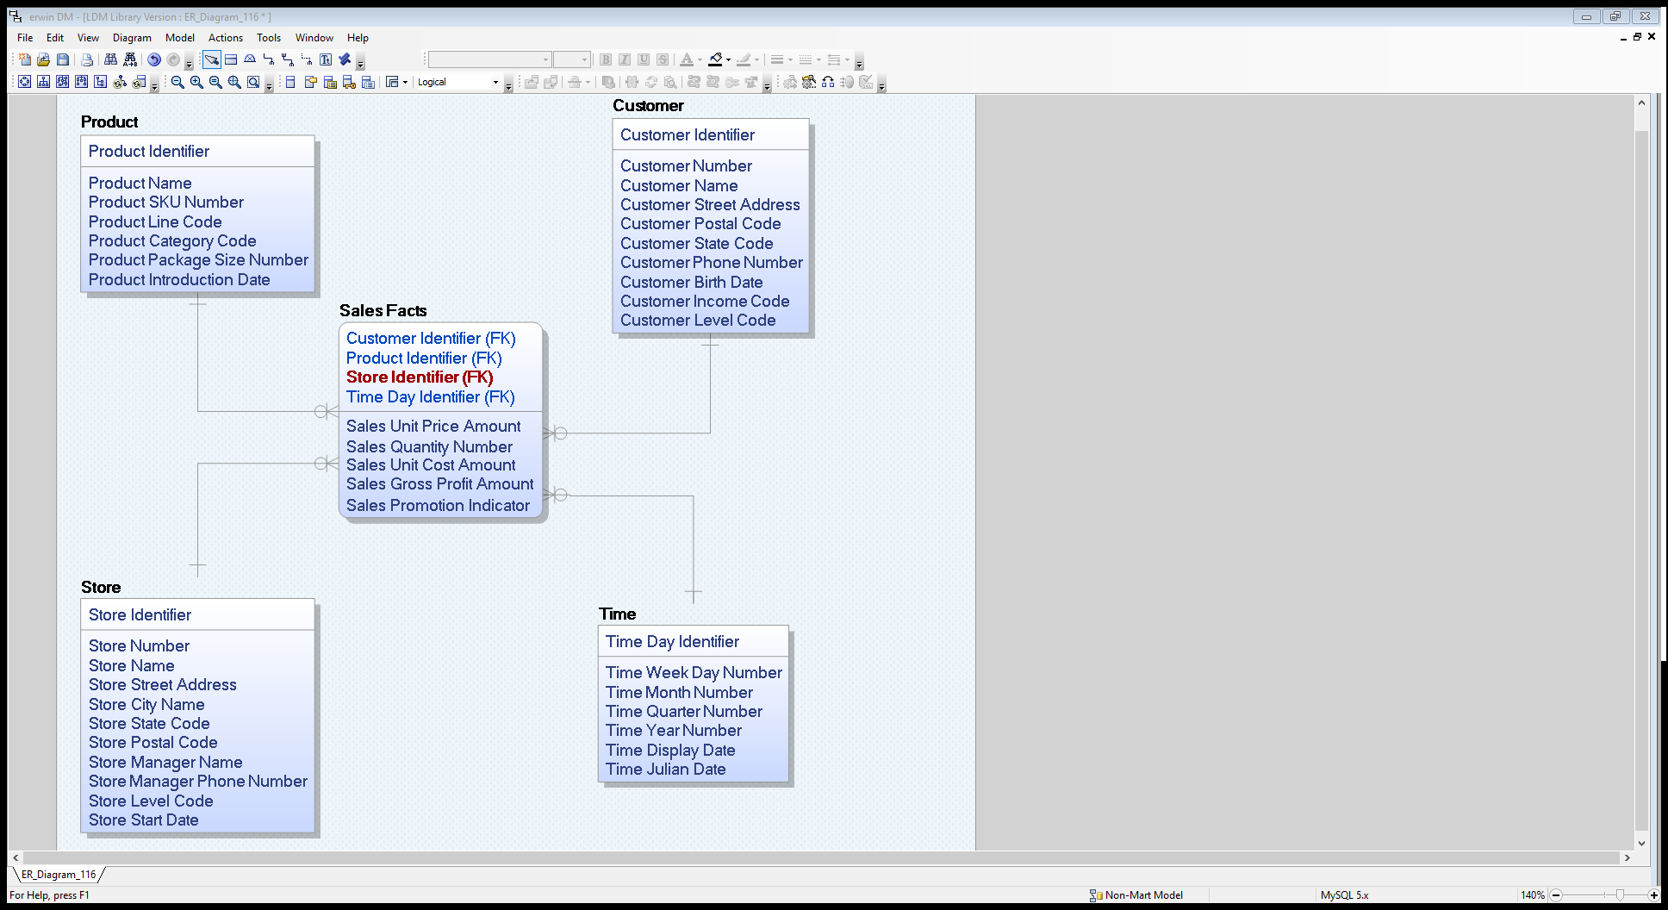
The Database - LDM

Slide 5
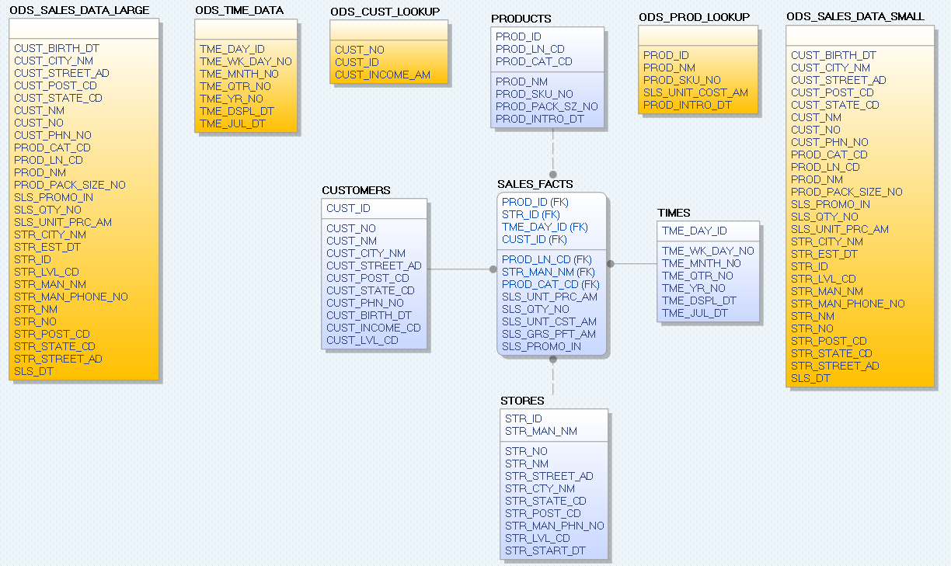
The Database - PDM

Slide 6
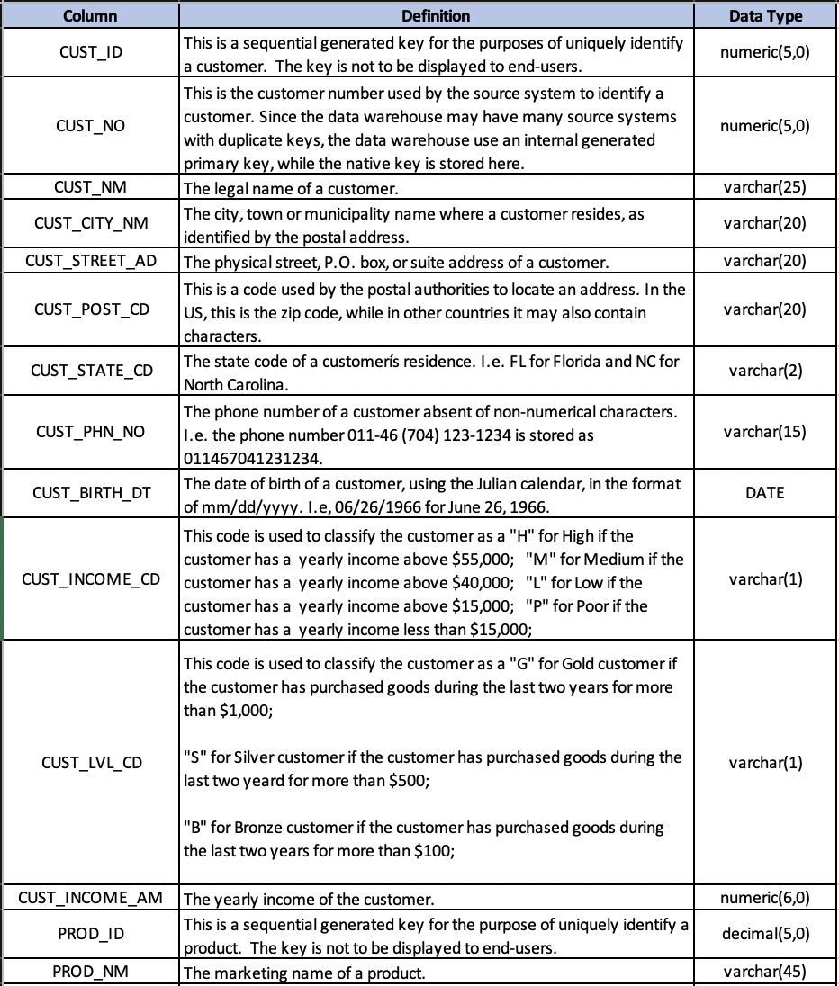
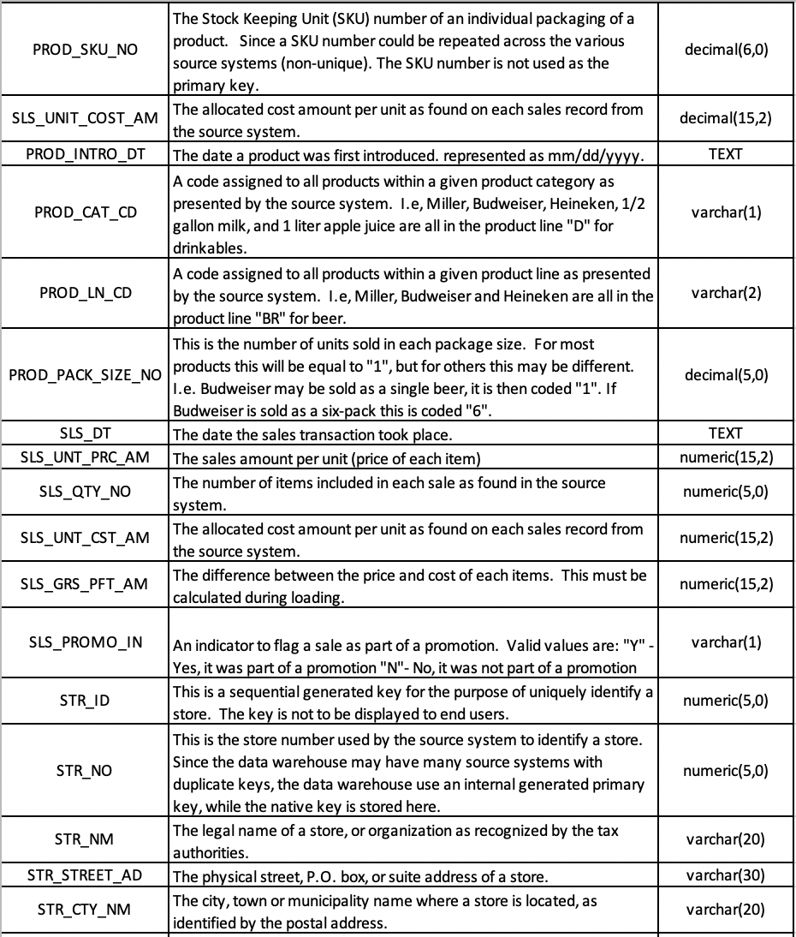
The Database – Data Dictionary

Slide 7
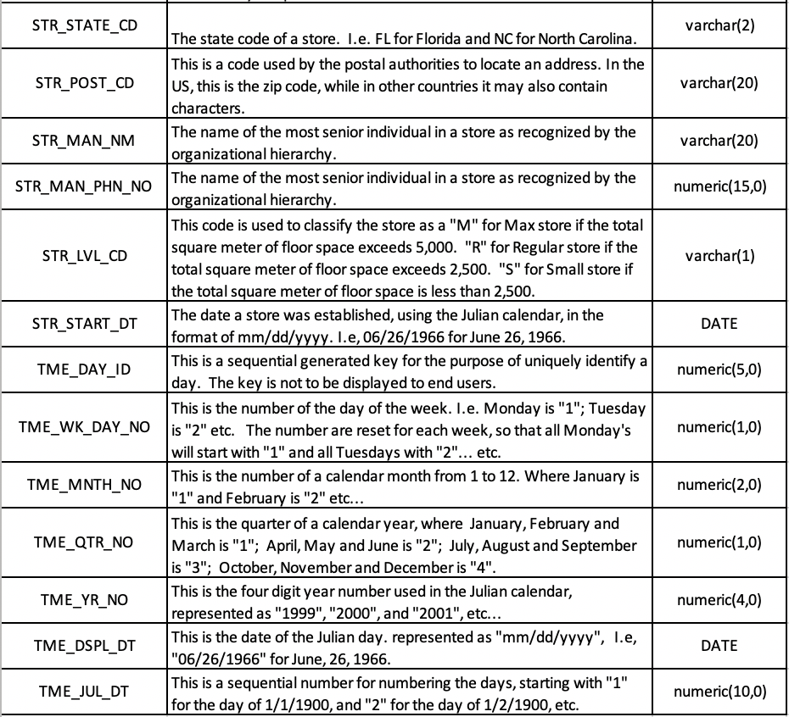
The Database – Data Dictionary

Slide 8
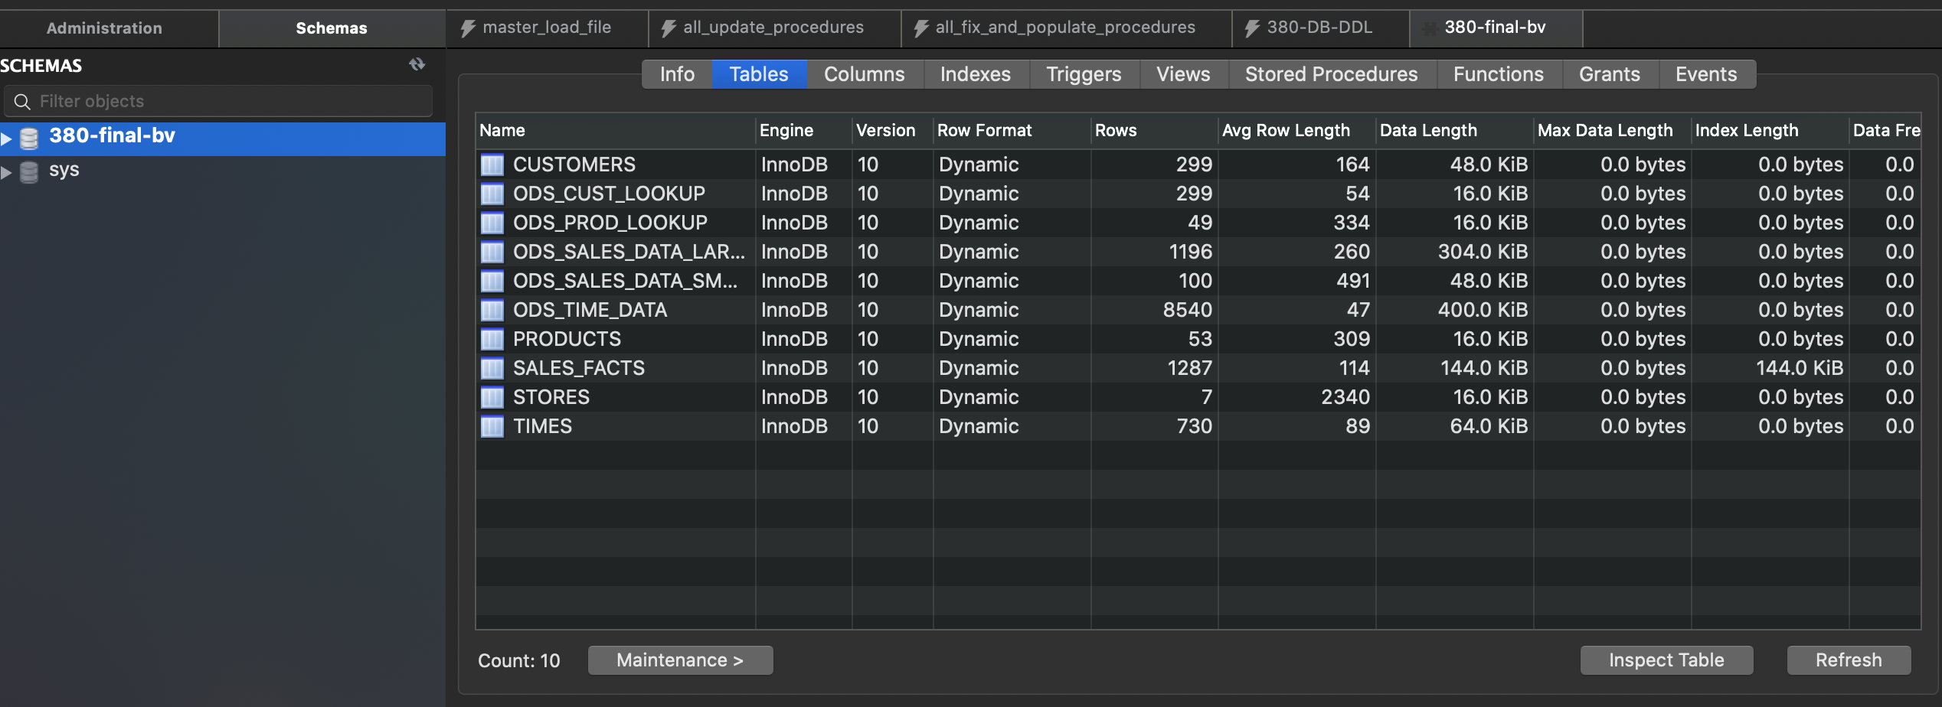
SLA Data Architecture

Slide 9
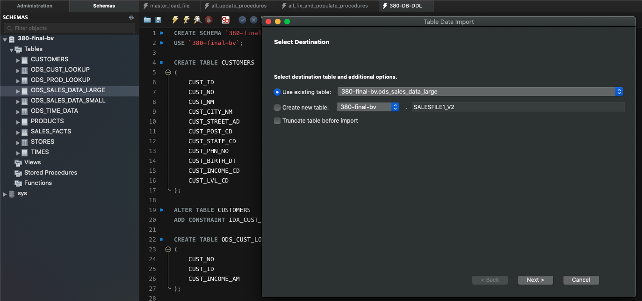
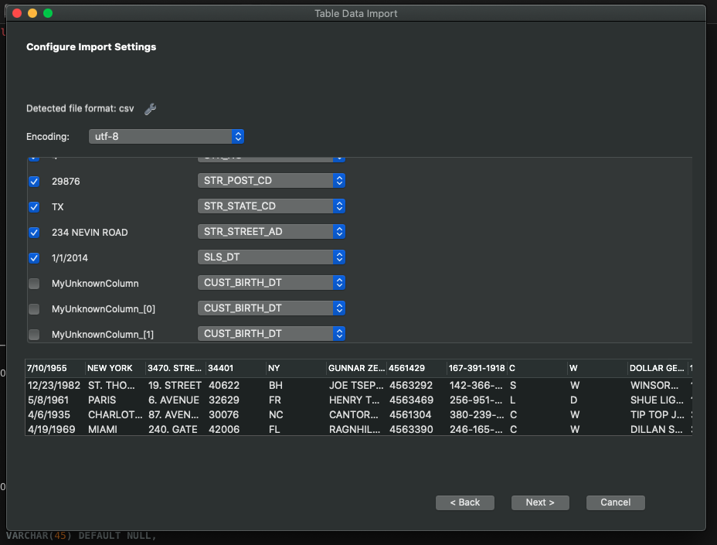
The ETL – Job 1: Import Wizard

Slide 10
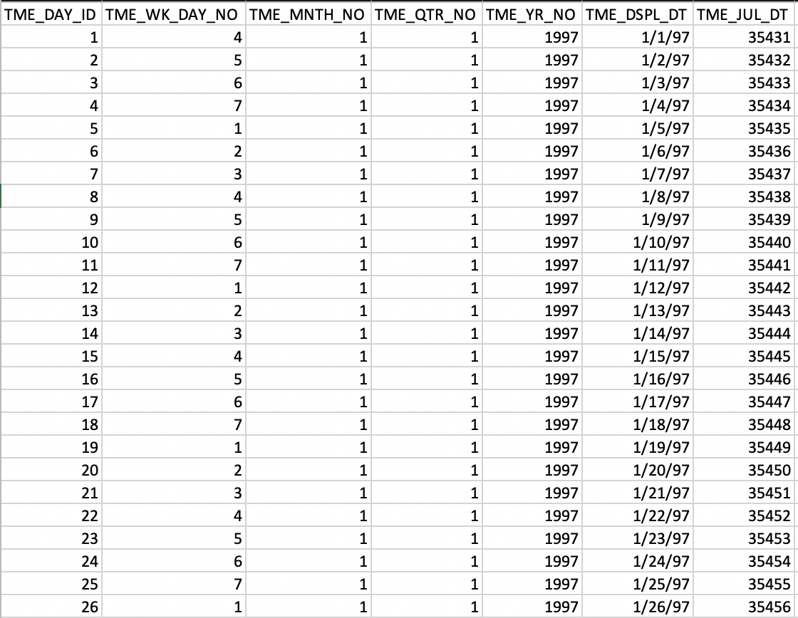
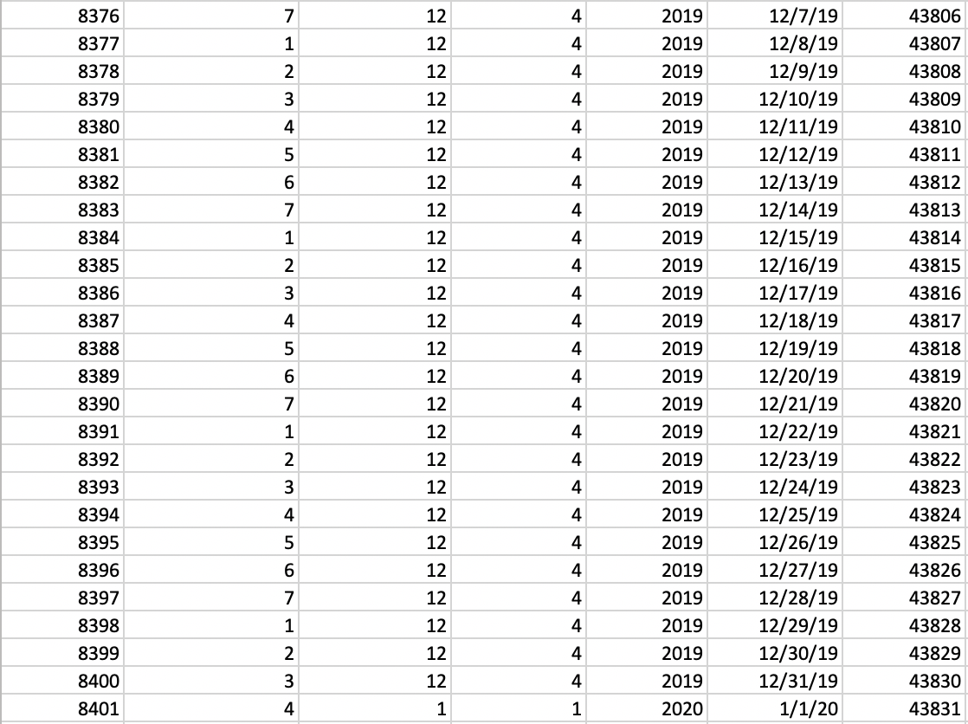
The ETL – Job 2: Create Time File

Slide 11
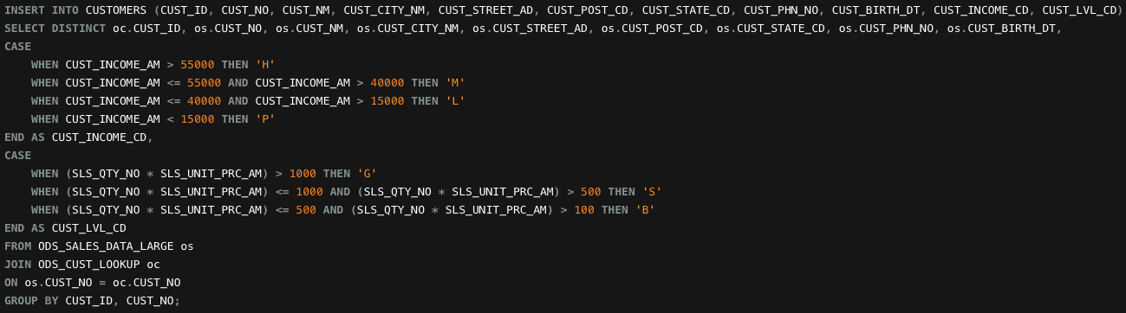
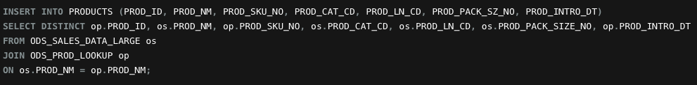
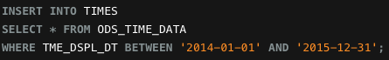
The ETL – Job 3: Load all dimensions (Unique)

Slide 12
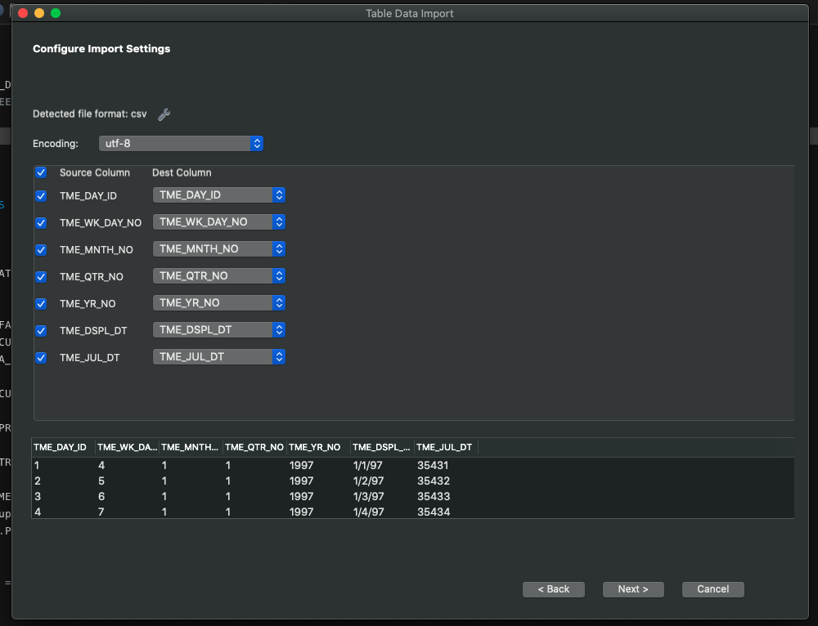
The ETL – Job 4: Load Time via Import Wizard

Slide 13
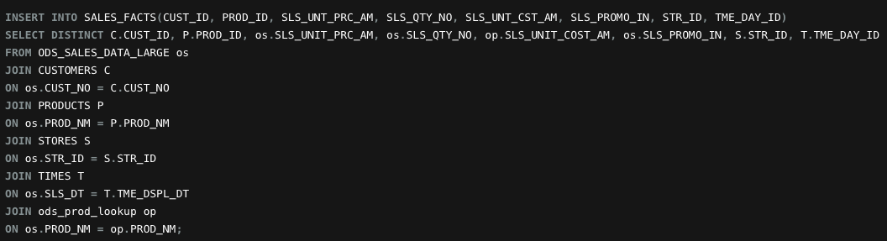
The ETL – Job 5: Load Sales Facts Table

Slide 14
The ETL – Job 6: Load Customer Inc to Table

Slide 15
The ETL – Job 7: Assign Income Level Code

Slide 16
The ETL – Job 8: Assign Prod ID to Product Table

Slide 17
The ETL – Job 9: Add Calculated Key Figures

Slide 18
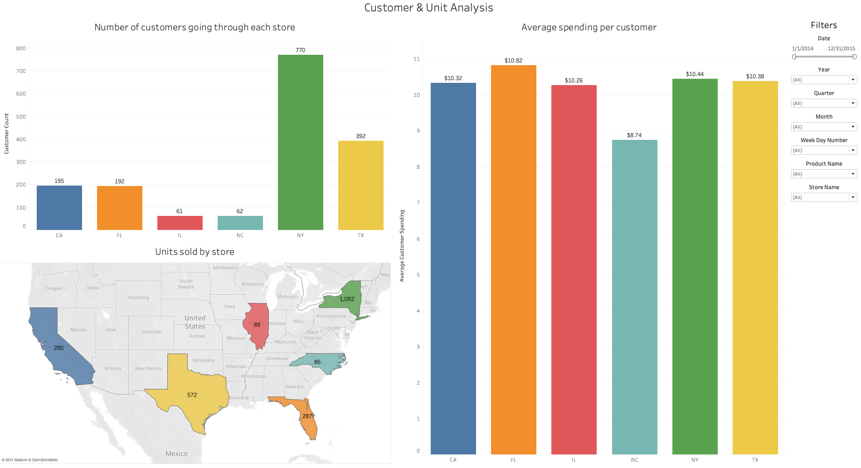
The Application Demo

Slide 19
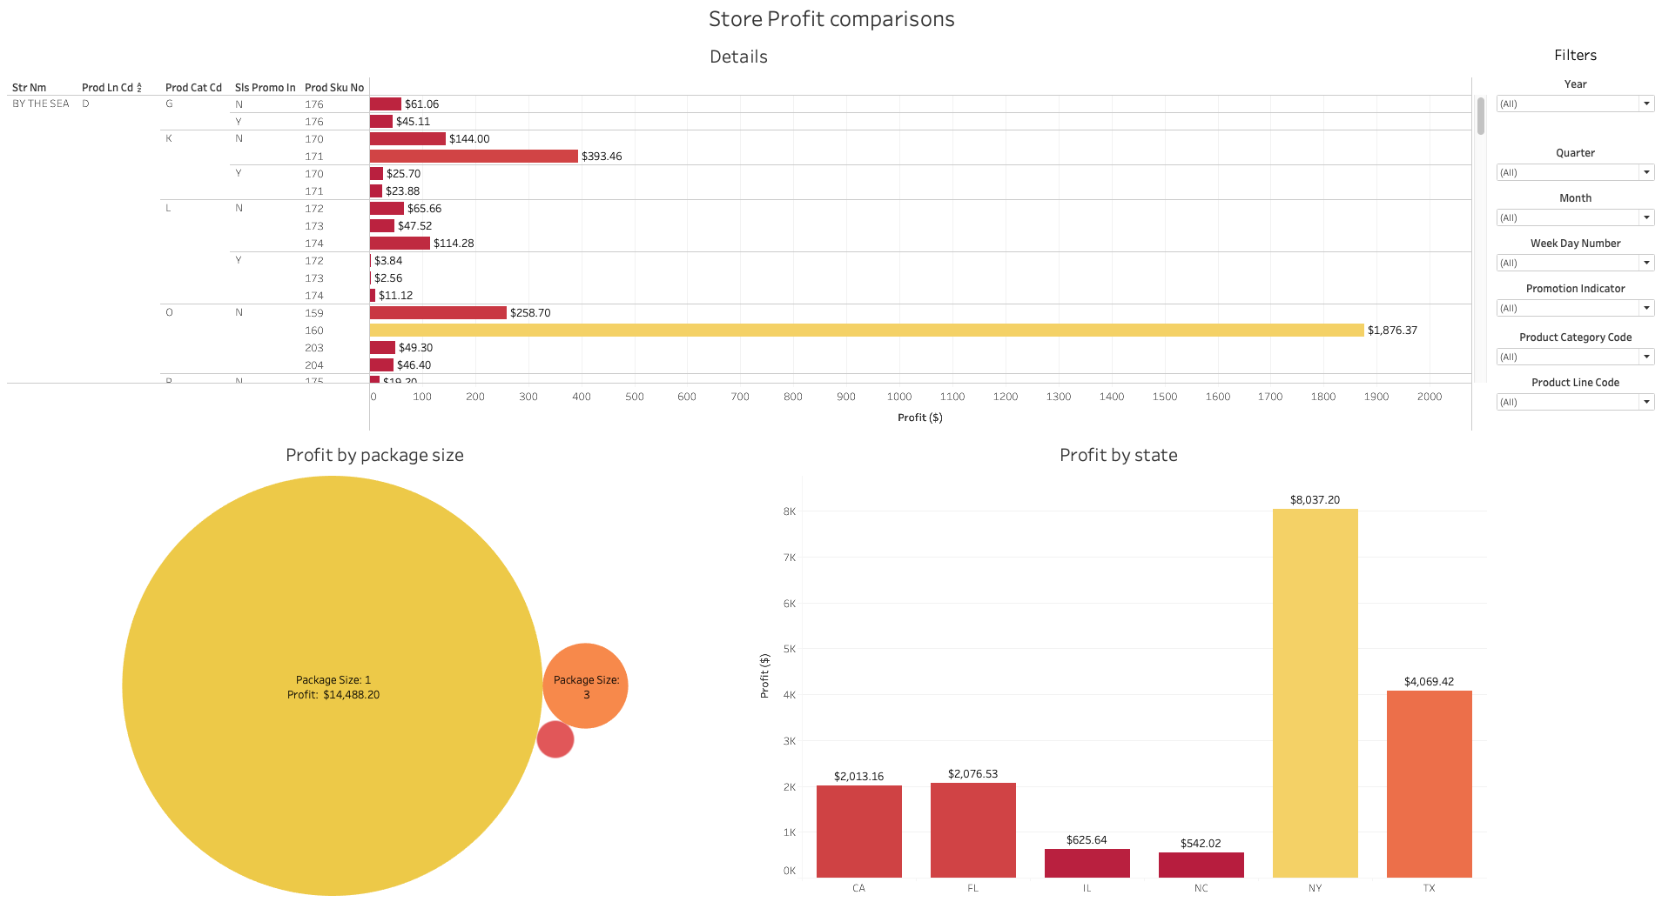
The Application Demo

Slide 20
The Application Demo
LIVE DEMO

Slide 21

How to contact me:
brett.vogelsang@my.lr.edu

